Slide 1



Data Science and Machine Learning
Generative AI II

Slide 2
Retrieval augmented generation (RAG)

Slide 3

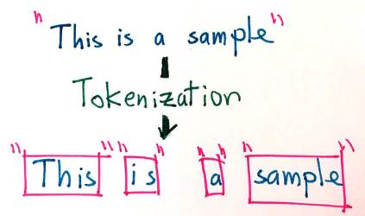
Embeddings
From words to numbers
Tokenization is the act of splitting strings into lists of “tokens” (not words, but very close)

Slide 4

Embeddings
From words to numbers

Slide 5
Embeddings
From words to numbers
What if we could represent the words via its “meaning” and not its letters?
Using only “letters”
User query: “Someone in my class had a question!
No Match
Student
Lab
Exercise

Slide 6
Using Semantic Similarity
Embeddings
From words to numbers
Dashboard
Cockpit
Training data:
FROM DOCUMENTATION
Cockpit Portfolio dashboard, leveraging data from C1st and C3, tracks revenues and CVC for pilots and contributors.
Client Cockpit uses C1st and C3 databases to highlight revenues and CVC metrics.
In Cockpit Portfolio, C1st and C3 data inform revenues and CVC for pilots and contributors.
Client Cockpit shows revenues and CVC, using C1st and C3 data sources.
Cockpit Portfolio dashboard integrates C1st and C3 data for revenues and CVC insights.
Client Cockpit leverages C1st and C3 to display revenues and CVC metrics.
Cockpit Portfolio uses C1st and C3 databases to analyze revenues and CVC for pilots and contributors.
….
Client Cockpit leverages data from C1st and C3 to present revenues and CVC.
Cockpit Portfolio provides revenues and CVC insights using C1st and C3 data.
Client Cockpit extracts revenues and CVC metrics from C1st and C3.
Cockpit Portfolio dashboard highlights revenues and CVC from C1st and C3.
Client Cockpit analyzes revenues and CVC using C1st and C3 databases.
Cockpit Portfolio leverages C1st and C3 to monitor revenues and CVC.
Client Cockpit displays revenues and CVC metrics, using data from C1st and C3.
FROM USERS’ EMAILS:
"Where is my dashboard? I think it is called Cockpit Portfolio, and it uses data from C1st and C3 to track revenues and CVC for pilots and contributors."
"Can I see revenues and CVC in the Client Cockpit using data from C1st and C3?"
"Is the Cockpit Portfolio dashboard integrating C1st and C3 data for revenues and CVC insights?"
"Does Client Cockpit show revenues and CVC metrics using C1st and C3 databases?"
"How does the Cockpit Portfolio leverage C1st and C3 data to analyze revenues and CVC for pilots and contributors?"and CVC from C1st and C3?"
"Is Client Cockpit analyzing revenues and CVC using C1st and C3 databases?"
"Does Cockpit Portfolio leverage C1st and C3 to monitor revenues and CVC?"
"Can Client Cockpit display revenues and CVC metrics using data from C1st and C3?"
C1st
Tableau
Pilot
Contributors
C3
Portfolio
Revenues
CVC
Client

Slide 7
Using Semantic Similarity
Embeddings
From words to numbers
Dashboard
Training data:
FROM DOCUMENTATION
Cockpit Portfolio dashboard, leveraging data from C1st and C3, tracks revenues and CVC for pilots and contributors.
Client Cockpit uses C1st and C3 databases to highlight revenues and CVC metrics.
In Cockpit Portfolio, C1st and C3 data inform revenues and CVC for pilots and contributors.
Client Cockpit shows revenues and CVC, using C1st and C3 data sources.
Cockpit Portfolio dashboard integrates C1st and C3 data for revenues and CVC insights.
Client Cockpit leverages C1st and C3 to display revenues and CVC metrics.
Cockpit Portfolio uses C1st and C3 databases to analyze revenues and CVC for pilots and contributors.
….
Client Cockpit leverages data from C1st and C3 to present revenues and CVC.
Cockpit Portfolio provides revenues and CVC insights using C1st and C3 data.
Client Cockpit extracts revenues and CVC metrics from C1st and C3.
Cockpit Portfolio dashboard highlights revenues and CVC from C1st and C3.
Client Cockpit analyzes revenues and CVC using C1st and C3 databases.
Cockpit Portfolio leverages C1st and C3 to monitor revenues and CVC.
Client Cockpit displays revenues and CVC metrics, using data from C1st and C3.
FROM USERS’ EMAILS:
"Where is my dashboard? I think it is called Cockpit Portfolio, and it uses data from C1st and C3 to track revenues and CVC for pilots and contributors."
"Can I see revenues and CVC in the Client Cockpit using data from C1st and C3?"
"Is the Cockpit Portfolio dashboard integrating C1st and C3 data for revenues and CVC insights?"
"Does Client Cockpit show revenues and CVC metrics using C1st and C3 databases?"
"How does the Cockpit Portfolio leverage C1st and C3 data to analyze revenues and CVC for pilots and contributors?"and CVC from C1st and C3?"
"Is Client Cockpit analyzing revenues and CVC using C1st and C3 databases?"
"Does Cockpit Portfolio leverage C1st and C3 to monitor revenues and CVC?"
"Can Client Cockpit display revenues and CVC metrics using data from C1st and C3?"
C1st
Tableau
Pilot
Contributors
C3
Revenues
CVC
Client
Cockpit
Portfolio

Slide 8
Using Semantic Similarity
Embeddings
From words to numbers
Dashboard
Training data:
FROM DOCUMENTATION
Cockpit Portfolio dashboard, leveraging data from C1st and C3, tracks revenues and CVC for pilots and contributors.
Client Cockpit uses C1st and C3 databases to highlight revenues and CVC metrics.
In Cockpit Portfolio, C1st and C3 data inform revenues and CVC for pilots and contributors.
Client Cockpit shows revenues and CVC, using C1st and C3 data sources.
Cockpit Portfolio dashboard integrates C1st and C3 data for revenues and CVC insights.
Client Cockpit leverages C1st and C3 to display revenues and CVC metrics.
Cockpit Portfolio uses C1st and C3 databases to analyze revenues and CVC for pilots and contributors.
….
Client Cockpit leverages data from C1st and C3 to present revenues and CVC.
Cockpit Portfolio provides revenues and CVC insights using C1st and C3 data.
Client Cockpit extracts revenues and CVC metrics from C1st and C3.
Cockpit Portfolio dashboard highlights revenues and CVC from C1st and C3.
Client Cockpit analyzes revenues and CVC using C1st and C3 databases.
Cockpit Portfolio leverages C1st and C3 to monitor revenues and CVC.
Client Cockpit displays revenues and CVC metrics, using data from C1st and C3.
FROM USERS’ EMAILS:
"Where is my dashboard? I think it is called Cockpit Portfolio, and it uses data from C1st and C3 to track revenues and CVC for pilots and contributors."
"Can I see revenues and CVC in the Client Cockpit using data from C1st and C3?"
"Is the Cockpit Portfolio dashboard integrating C1st and C3 data for revenues and CVC insights?"
"Does Client Cockpit show revenues and CVC metrics using C1st and C3 databases?"
"How does the Cockpit Portfolio leverage C1st and C3 data to analyze revenues and CVC for pilots and contributors?"and CVC from C1st and C3?"
"Is Client Cockpit analyzing revenues and CVC using C1st and C3 databases?"
"Does Cockpit Portfolio leverage C1st and C3 to monitor revenues and CVC?"
"Can Client Cockpit display revenues and CVC metrics using data from C1st and C3?"
C1st
Tableau
Pilot
Contributors
C3
Revenues
CVC
Client
Cockpit
Portfolio

Slide 9
Using Semantic Similarity
Embeddings
From words to numbers
Training data:
FROM DOCUMENTATION
Cockpit Portfolio dashboard, leveraging data from C1st and C3, tracks revenues and CVC for pilots and contributors.
Client Cockpit uses C1st and C3 databases to highlight revenues and CVC metrics.
In Cockpit Portfolio, C1st and C3 data inform revenues and CVC for pilots and contributors.
Client Cockpit shows revenues and CVC, using C1st and C3 data sources.
Cockpit Portfolio dashboard integrates C1st and C3 data for revenues and CVC insights.
Client Cockpit leverages C1st and C3 to display revenues and CVC metrics.
Cockpit Portfolio uses C1st and C3 databases to analyze revenues and CVC for pilots and contributors.
….
Client Cockpit leverages data from C1st and C3 to present revenues and CVC.
Cockpit Portfolio provides revenues and CVC insights using C1st and C3 data.
Client Cockpit extracts revenues and CVC metrics from C1st and C3.
Cockpit Portfolio dashboard highlights revenues and CVC from C1st and C3.
Client Cockpit analyzes revenues and CVC using C1st and C3 databases.
Cockpit Portfolio leverages C1st and C3 to monitor revenues and CVC.
Client Cockpit displays revenues and CVC metrics, using data from C1st and C3.
FROM USERS’ EMAILS:
"Where is my dashboard? I think it is called Cockpit Portfolio, and it uses data from C1st and C3 to track revenues and CVC for pilots and contributors."
"Can I see revenues and CVC in the Client Cockpit using data from C1st and C3?"
"Is the Cockpit Portfolio dashboard integrating C1st and C3 data for revenues and CVC insights?"
"Does Client Cockpit show revenues and CVC metrics using C1st and C3 databases?"
"How does the Cockpit Portfolio leverage C1st and C3 data to analyze revenues and CVC for pilots and contributors?"and CVC from C1st and C3?"
"Is Client Cockpit analyzing revenues and CVC using C1st and C3 databases?"
"Does Cockpit Portfolio leverage C1st and C3 to monitor revenues and CVC?"
"Can Client Cockpit display revenues and CVC metrics using data from C1st and C3?"
Pilot
C1st
Contributors
C3
Revenues
CVC
Dashboard
Tableau
Client
Cockpit
Portfolio

Slide 10
Using Semantic Similarity
Embeddings
This is called an embedding vector
Pilot
C1st
Contributors
C3
Revenues
CVC
Dashboard
Tableau
Client
Cockpit
Portfolio

Slide 11
Using Semantic Similarity
Embeddings
All this to…
User query: “Can you tell me where my dashboard with my MNCs is?
Pilot
C1st
Atlas 2
MNCs
Contributors
Capital
C3
Revenues
CVC
Can you tell me where my dashboard with my MNCs is?
Deposits
Docname; source
Docname;source
Docname;source
Docname;source
Docname;source
Docname;source
Link
Dashboard
Tableau
PowerBI
Client
Cockpit
Portfolio

Slide 12
Using Semantic Similarity
Embeddings
Now imagine this on datasource metadata
Atlas2 field about the Product3 of C3 that the clients has bough
Field description
Field description
Field description
Field description
C1st
Field description
Atlas 2
Field description
Field description
Field description
Field description
Field description
Field description
Field description
Field description
Atlas2 field about the Product3 of C3 that the clients has bough
Top15 most related fields:
Fieldname; datasource
Fieldname; datasource
Fieldname; datasource
Fieldname; datasource
…
Fieldname; datasource
Fieldname; datasource
Field description
Field description
C3
Field description
Field description
Field description
Field description
Field description

Slide 13
Using Semantic Similarity
Embeddings
Now imagine this on datasource metadata
All fields that connect to RMPM
Field description
Field description
Field description
Field description
C1st
Field description
Atlas 2
Field description
Field description
Field description
Field description
Field description
Field description
Field description
Field description
All fields that connect to RMPM
Top15 most related fields:
Fieldname; datasource
Fieldname; datasource
Fieldname; datasource
Fieldname; datasource
…
Fieldname; datasource
Fieldname; datasource
Field description
Field description
C3
Field description
Field description
Field description
Field description
Field description

Slide 14
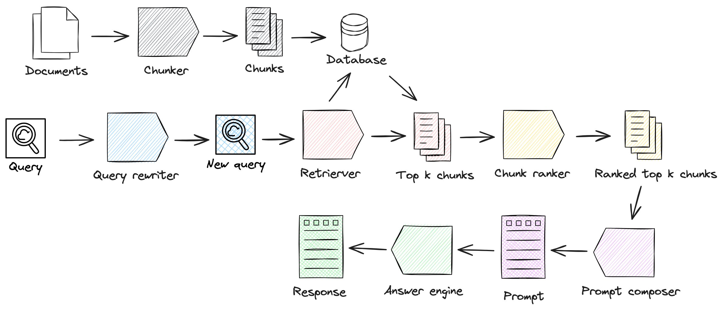
RAG (Retreived Augmented Generation) Bring it all together
Retreiver step
Generation step

Slide 15
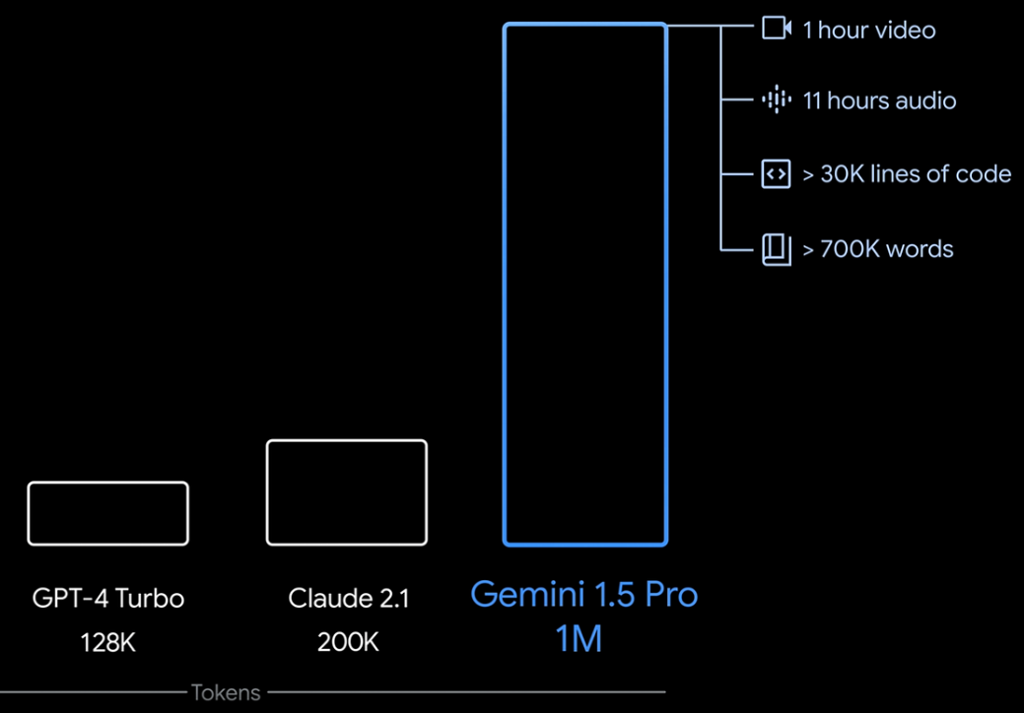
RAG

Slide 16

Knowledge cut-offs in LLMs
Prompt
Model
Completion
Who is the current Prime Minister of the United Kingdom?
Who is the current Prime Minister of the United Kingdom?
Boris Johnson
LLM

Slide 17









LLM-powered applications
LLM
External Data Sources
User Application
Orchestration library
Documents
Database Web
External Applications

Slide 18




Retrieval Augmented Generation (RAG)
External information sources
Query encoder
LLM
Retriever
Lewis et al. 2020 “Retrieval-Augmented Generation for Knowledge-Intensive NLP Tasks”

Slide 19



Example: Searching legal documents
Input query
UNITED STATES DISTRICT COURT SOUTHERN DISTRICT OF MAINE
CASE NUMBER: 22-48710BI-SME
Busy Industries (Plaintiff) vs.
State of Maine (Defendant)
UNITED STATES DISTRICT COURT SOUTHERN DISTRICT OF MAINE
CASE NUMBER: 22-48710BI-SME
Busy Industries (Plaintiff) vs.
State of Maine (Defendant)
Who is the plaintiff in case 22-48710BI-SME?
Who is the plaintiff in case 22-48710BI-SME?
documents
Query Encoder
External Information Sources

Slide 20

Example: Searching legal documents
UNITED STATES DISTRICT COURT SOUTHERN DISTRICT OF MAINE
CASE NUMBER: 22-48710BI-SME
Completion
Busy Industries (Plaintiff) vs.
State of Maine (Defendant)
Busy Industries
LLM
Who is the plaintiff in case 22-48710BI-SME?

Slide 21
RAG integrates with many types of data sources
External Information Sources
Documents
Wikis
Expert Systems
Web pages
Databases
External information sources
Query encoder
Vector Store
Retriever

Slide 22

Data preparation for vector store for RAG
Two considerations for using external data in RAG:
1. Data must fit inside context window
Prompt context limit few 1000 tokens
Single document too large to fit in window
Split long sources into short chunks

Slide 23



Data preparation for RAG
Two considerations for using external data in RAG:
Data must fit inside context window
Data must be in format that allows its relevance to be assessed at inference time: Embedding vectors
fire
Prompt text converted to embedding vectors
book
jumps
X₁
X₂
X₃
X₄
X₅
fox
swim
whale
Cosine similarity

Slide 24

Data preparation for RAG
Two considerations for using external data in RAG:
Data must fit inside context window
Data must be in format that allows its relevance to be assessed at inference time: Embedding vectors
Process each chunk with LLM to produce embedding vectors
X₁
X₂
X₃
X₄
X₅
X₆
X₁
X₂
X₃
X₄
X₁
X₂
X₃
X₄
X₅
X₁
X₂
X₃
X₄
X₅
X₆
X₇

Slide 25


Vector database search
Text 1
Each text in vector store is identified by a key
Enables a citation to be included in completion
Text 5
Text 2
Prompt
Text 4
Text 6
Text 3

Slide 26
RAG (Retreived Augmented Generation) Bring it all together

Slide 27
RAG (Retreived Augmented Generation) Bring it all together
Retreiver step
Generation step

Slide 28
RAG (Retreived Augmented Generation) Bring it all together
prompt = f"""
## INTRODUCTION
You are a Chatbot designed to help answer technical questions about the software at BNPP.
The user asked: "{user_question}"
## CONTEXT
Technical Documentation for the software:
'''
{_get_document_prompt(docs)}
'''
## RESTRICTIONS
Refer to the products by their names.
Be clear, transparent, and factual: only state what is in the context without providing opinions or subjectivity.
Answer the question based solely on the context above; if you do not know the answer, be clear with the user that you do not know.
Only respond to questions related to the products, avoiding jokes, offensive remarks, and discussions on religion or sexuality.
If the user does not provide sufficient context, do not answer and instead ask for more information on what the user wants to know.
## TASK
First, answer directly to the user, if possible
Second, point the user int he right direction of the documentation
## RESPONSE STRUCTURE:
'''
[answer text]]
Source:
• From pages [...] of the Technical Documentation for *Product1* (link)
• From pages [...] of the Technical Documentation for *Product2* (link)
'''
## CONVERSATION:
User: {user_question}
Agent:
"""

Slide 29
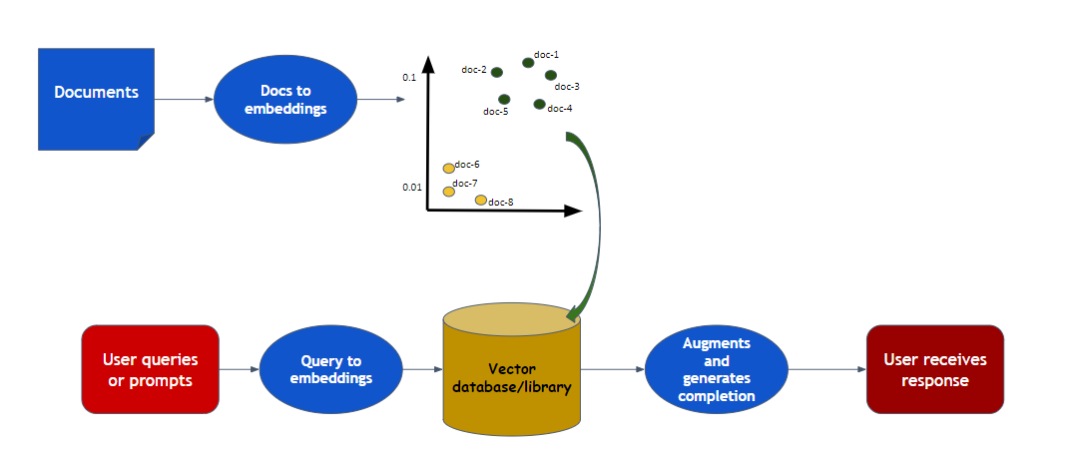
RAG (Retreived Augmented Generation) Bring it all together

Slide 30
Lets code this out?

